Slide 1

MACHINE LEARNING FINAL PROJECT
Hodaya Moshayev and Zohar Klimovsky

Slide 2

Real / Fake Job Classification
The dataset “The Employment Scam Aegean Dataset “ contains of 18K job descriptions out of which about 800 are fake.
The data consists of both textual information and meta-information about the jobs.
This dataset will be used to create classification models which can learn the fraudulent job descriptions.

Slide 3

columns
corr
Sns.pairplot
Correlation

Slide 4
Imbalanced data
Balanced data
4.5%

Slide 5
Correlation matrix
Before
After

Slide 6

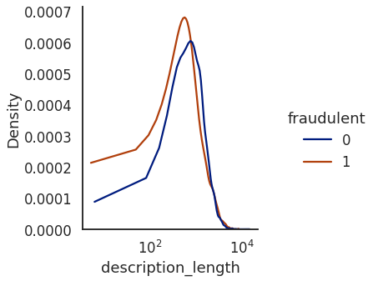
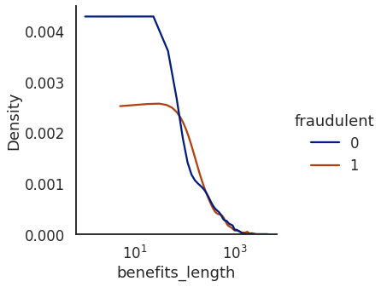
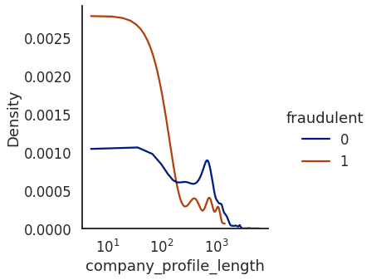
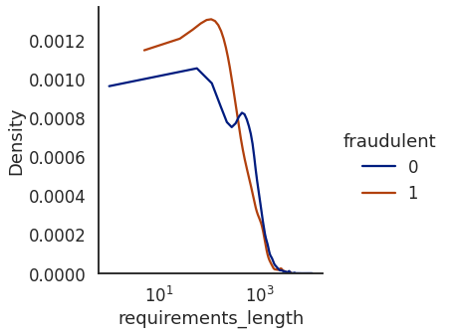
Length of text fields

Slide 7
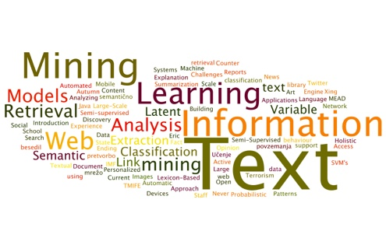
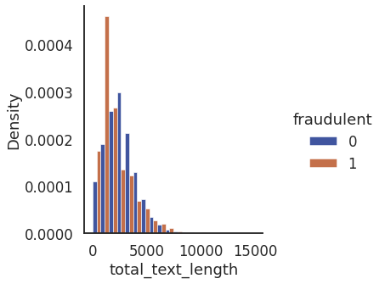
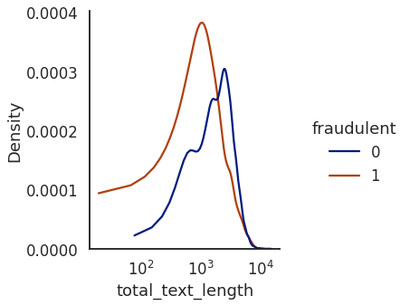

Slide 8

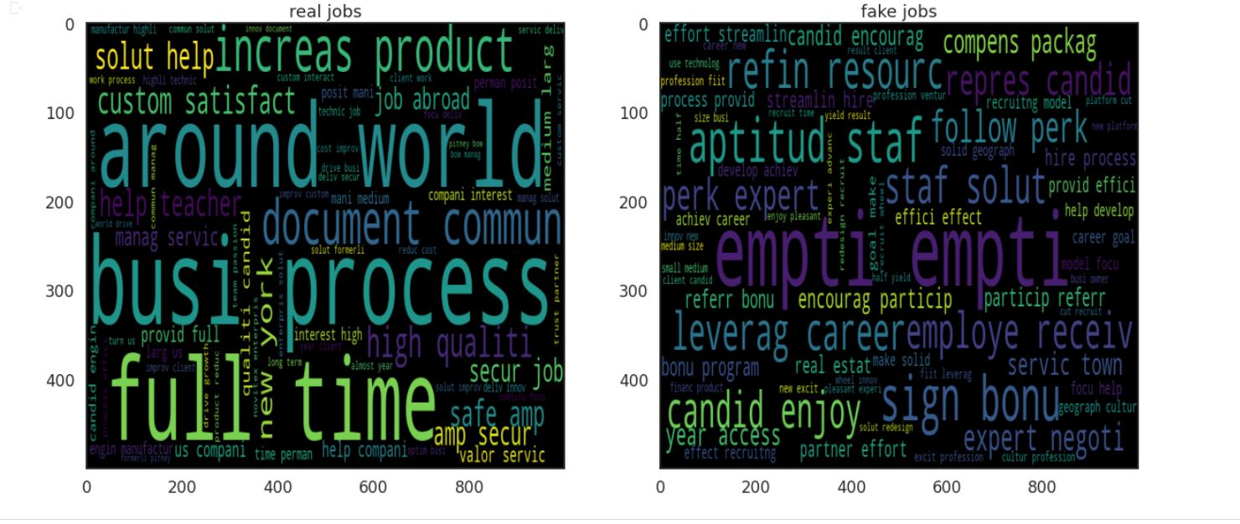
Text Mining

Slide 9
Encoding and Scaling
MinMax Scaler
LabelEncoder

Slide 10
MODEL BUILDINIG
KNN
Random Forest
Logistic Regression
Naïve Bayes
Decision Tree
SVM

Slide 11

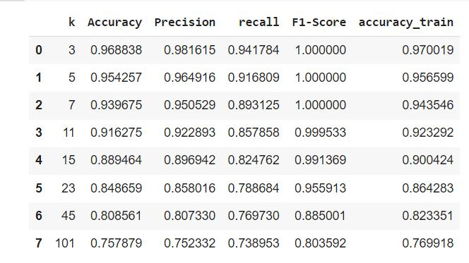
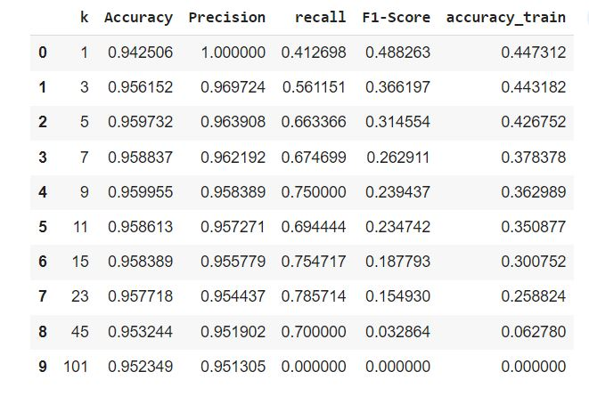
KNN
Balanced
Imbalanced

Slide 12

Logistic regression | SVM | Decision Tree | Naïve Bayes | Balanced Dataset
79.87% | 75% | 98.77% | 79.21% | Accuracy
80.03% | 74.74% | 100% | 78.38% | Accuracy of train
79.30% | 71.59% | 97.59% | 79.51% | Precision
80.75% | 82.76% | 100% | 78.21% | Recall
80.02% | 76.77% | 98.78% | 79.06% | F1-score
0.51s | 54.88s | 0.19s | 0.05s | Time

Slide 13
Logistic regression | SVM | Decision Tree | Naïve Bayes | Balanced Dataset
79.87% | 75% | 98.77% | 79.21% | Accuracy
80.03% | 74.74% | 100% | 78.38% | Accuracy of train
79.30% | 71.59% | 97.59% | 79.51% | Precision
80.75% | 82.76% | 100% | 78.21% | Recall
80.02% | 76.77% | 98.78% | 79.06% | F1-score
0.51s | 54.88s | 0.19s | 0.05s | Time
Logistic regression | SVM | Decision Tree | Naïve Bayes | Imbalanced Dataset
95.28% | 95.77% | 96.62% | 93.62% | Accuracy
95.36% | 94.95% | 100% | 93.75% | Accuracy of train
74.19% | 0.00% | 63.97% | 35.22% | Precision
10.18% | 0.00% | 71.82% | 41.04% | Recall
17.90% | 0.00% | 67.67% | 37.91% | F1-score
0.24s | 4.37s | 0.19s | 0.04s | Time

Slide 14

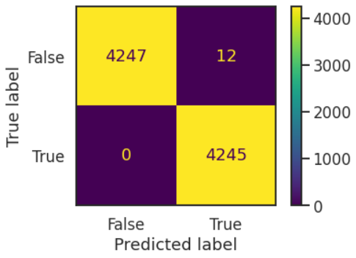
Bagging – Random Forest
99.86% | 98.32% | Accuracy
100% | 100% | Accuracy of train
99.72% | 94.97% | Precision
100% | 69.27% | Recall
99.86% | 80.11% | F1-score
3.56s | 2.49s | Time
Imbalanced
Balanced

Slide 15

OVERFITTING PROBLEM
Changing the depth of the tree in both
Random Forest and Decision Tree Classifiers
Depth = { 5 , 7, 9, 15, 19, 21}

Slide 16

Depth = 5
Random Forest | Decision Tree
90.05% | 87.95% | Accuracy
89.93% | 87.94% | Accuracy of train
89.02% | 84.76% | Precision
91.33% | 92.49% | Recall
90.16% | 88.45% | F1-score
2.02s | 0.14s | Time

Slide 17
Depth = 7
Random Forest | Decision Tree
94.36% | 91.53% | Accuracy
94.19% | 92.10% | Accuracy of train
92.66% | 88.95% | Precision
96.33% | 94.92% | Recall
94.46% | 91.79% | F1-score
2.46s | 0.13s | Time

Slide 18
Depth = 9
Random Forest | Decision Tree
96.60% | 94.54% | Accuracy
96.33% | 95.22% | Accuracy of train
94.69% | 91.96% | Precision
98.73% | 97.60% | Recall
96.67% | 94.70% | F1-score
2.83s | 0.15s | Time

Slide 19
Depth = 15
Random Forest | Decision Tree
98.73% | 97.62% | Accuracy
98.96% | 98.38% | Accuracy of train
97.52% | 95.46% | Precision
100% | 100% | Recall
98.74% | 97.68% | F1-score
3.4s | 0.18s | Time

Slide 20
Depth = 19
Random Forest | Decision Tree
99.25% | 98.17% | Accuracy
99.5% | 99.15% | Accuracy of train
98.51% | 96.56% | Precision
100% | 99.88% | Recall
99.25% | 98.19% | F1-score
3.42s | 0.2s | Time

Slide 21
Depth = 21
Random Forest | Decision Tree
99.41% | 98.39% | Accuracy
99.72% | 99.46% | Accuracy of train
98.84% | 96.87% | Precision
100% | 100% | Recall
99.41% | 98.41% | F1-score
3.51s | 0.18s | Time

Slide 22
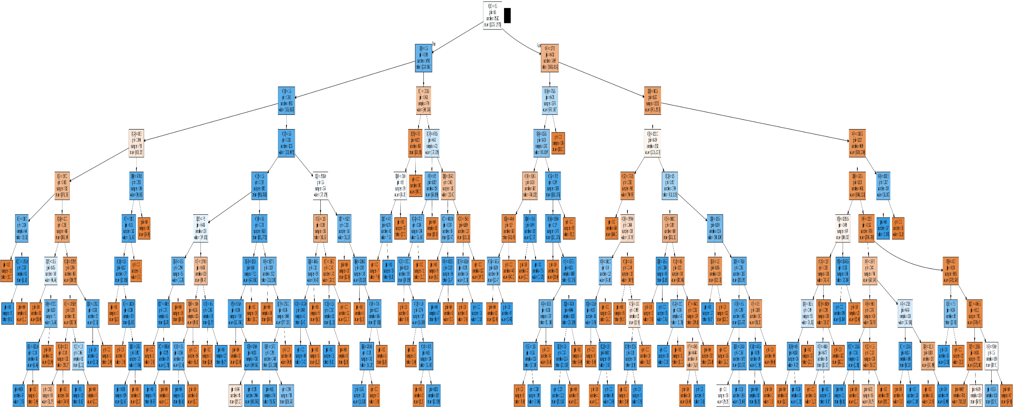
Decision Tree of Depth = 9

Slide 23
Conclusions
Decision Tree
Random Forest
KNN

Slide 24
IMPROVMENTS:
PCA
Parameters of SVM, LR, NB
Statistical Processing
Undersampling

Slide 25
The End
https://www.kaggle.com/code/nithil001/real-fake-job-classification‏‏
https://www.kaggle.com/code/szeyeung/real-or-fake-job-postings-ensemble-model‏‏
moodle jct
scikit-learn.org

